Slide 1
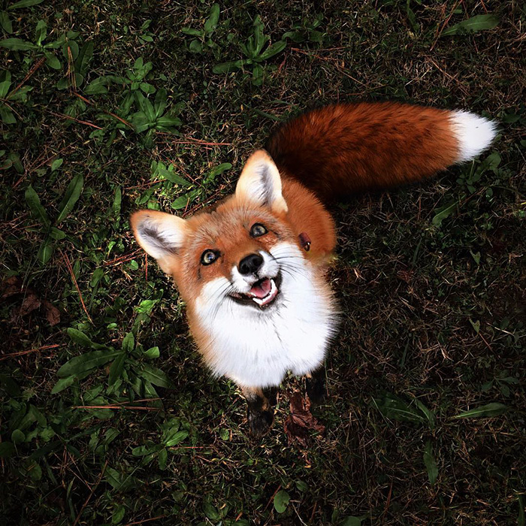
RED FOXES
BY KALLISTA MOODY

Slide 2
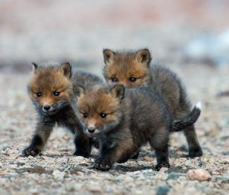
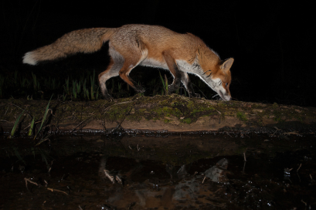
Basic facts
At birth, red foxes are brown or gray…
…And some grow to be golden,
silver, black, or reddish-brown.
In winter red foxes meet to mate, and in March the vixen gives birth to 2-12 kits.
Red foxes are mammals and omnivores.
They are most active at night.
Generally, they live 2-4 years
in the wild and weigh 6.5
to 24 pounds.

Slide 3

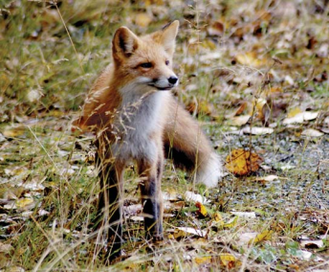
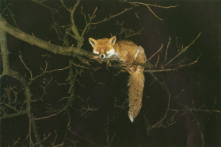
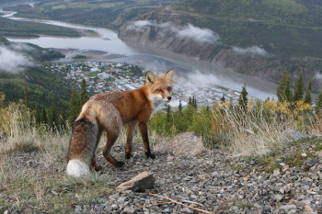
habitat
Red foxes inhabit the northern hemisphere in Eurasia, North America, North Africa, The Arctic Circle, and Australia. Red Foxes live in forests, f
grasslands,
mountains,
and deserts.
Red foxes also live among humans.
They have been spotted in many city
centers. In captivity they
can live up to 15 years, similar to dogs.

Slide 4
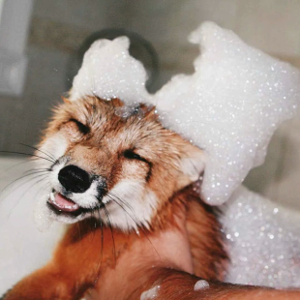

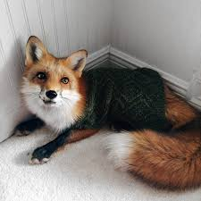
habitat continued
Foxes live in dens that they dig, or have been
previously occupied by a woodchuck, badger,
etc. If they are living near humans, they will
eat trash and pet food. Red foxes are in
danger of becoming extinct. People trap them
for their long and soft fur. Fox pelts are very
valuable, and the animals are raised on fur farms.
In some states it is legal to own foxes, and
sometimes they’re
rescued from fur
farms.
Red foxes can form
bonds with dogs and
cats, even dogs bred
for fox hunting.

Slide 5
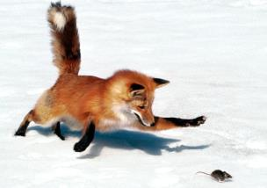
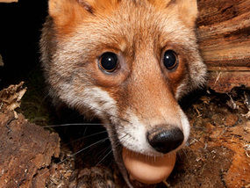
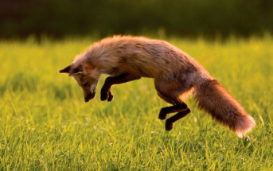
diet
A Red fox’s diet is very diverse. They eat rodents, rabbits, birds, small game, eggs, fruits, berries, veggies, fish, frogs, crickets, caterpillars, crayfish, beetles, grasses, and even worms. They store their food when full.
other facts
…Red foxes are well known for being cunning and intelligent.
…One of the main characteristics of a Red fox is their tail; or brush. They use it to communicate, keep warm, and for balance.
…Red fox’s main enemies are humans, but coyotes, bears, wolves, and mountain lions also pose a threat especially if engaged in a fight regarding food or territory.

Slide 6
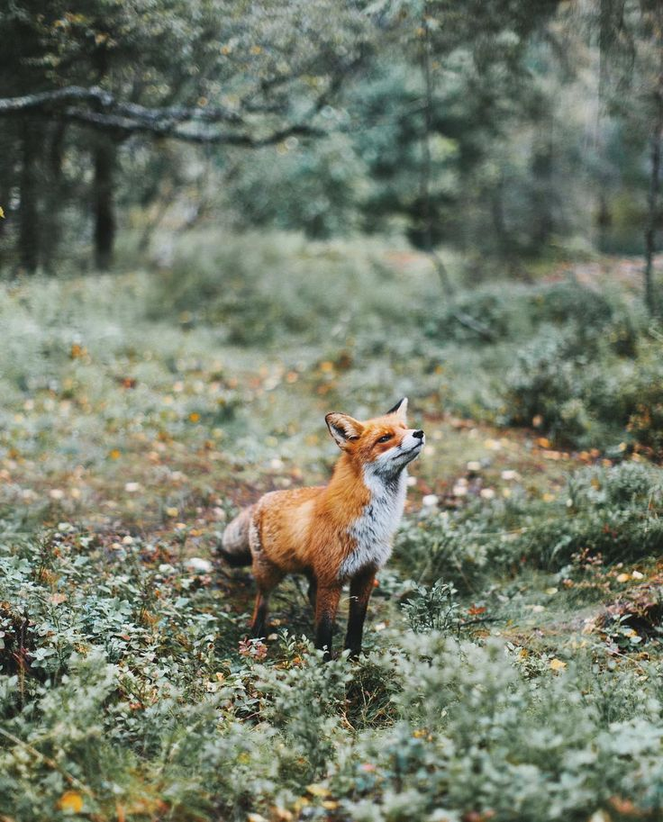
reasons I picked red foxes
Red foxes are very
intelligent and are such
interesting animals, and
there is so much to learn
about them. I find it
interesting that they are
more closely related to cats
versus dogs, and
I’m curious to learn more
about them.

